Slide 1
AI on the Edge
Deploying Models Outside the Data Center
Notes:
Talking about DevOps, IoTOps, MLOps
Discuss scenarios from my team

Slide 2
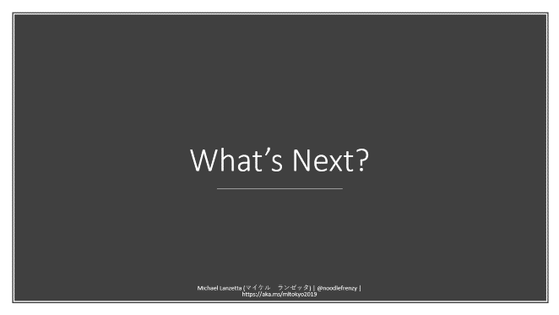

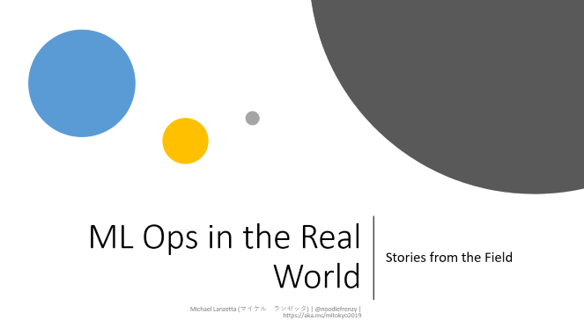
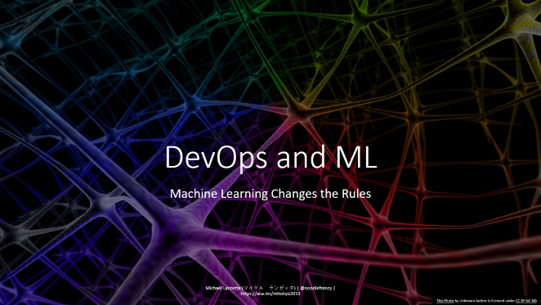
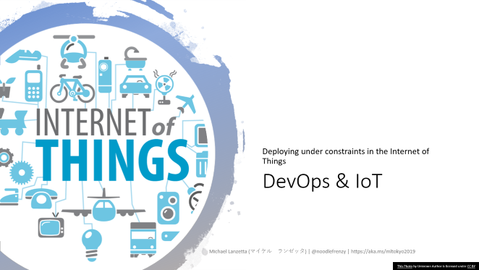
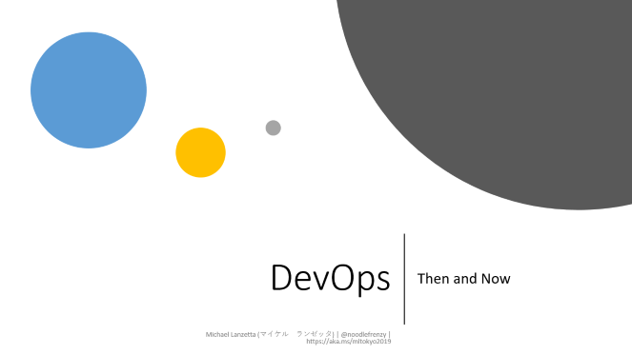
Agenda
Notes:
Agenda
Current State
DevOps, IoT Ops, ML Ops
Real World Scenarios
The Future

Slide 3

State of Things
AI on the Edge is a smooth, easy journey…

Slide 4
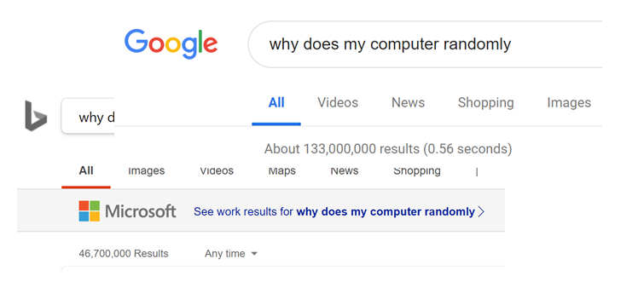
Computers are Deterministic

Slide 5
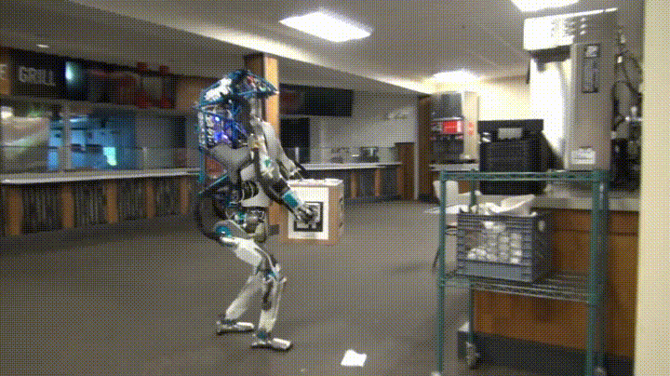
AI is State of the Art
Notes:
Cite: Giphy via r/shittyrobots

Slide 6
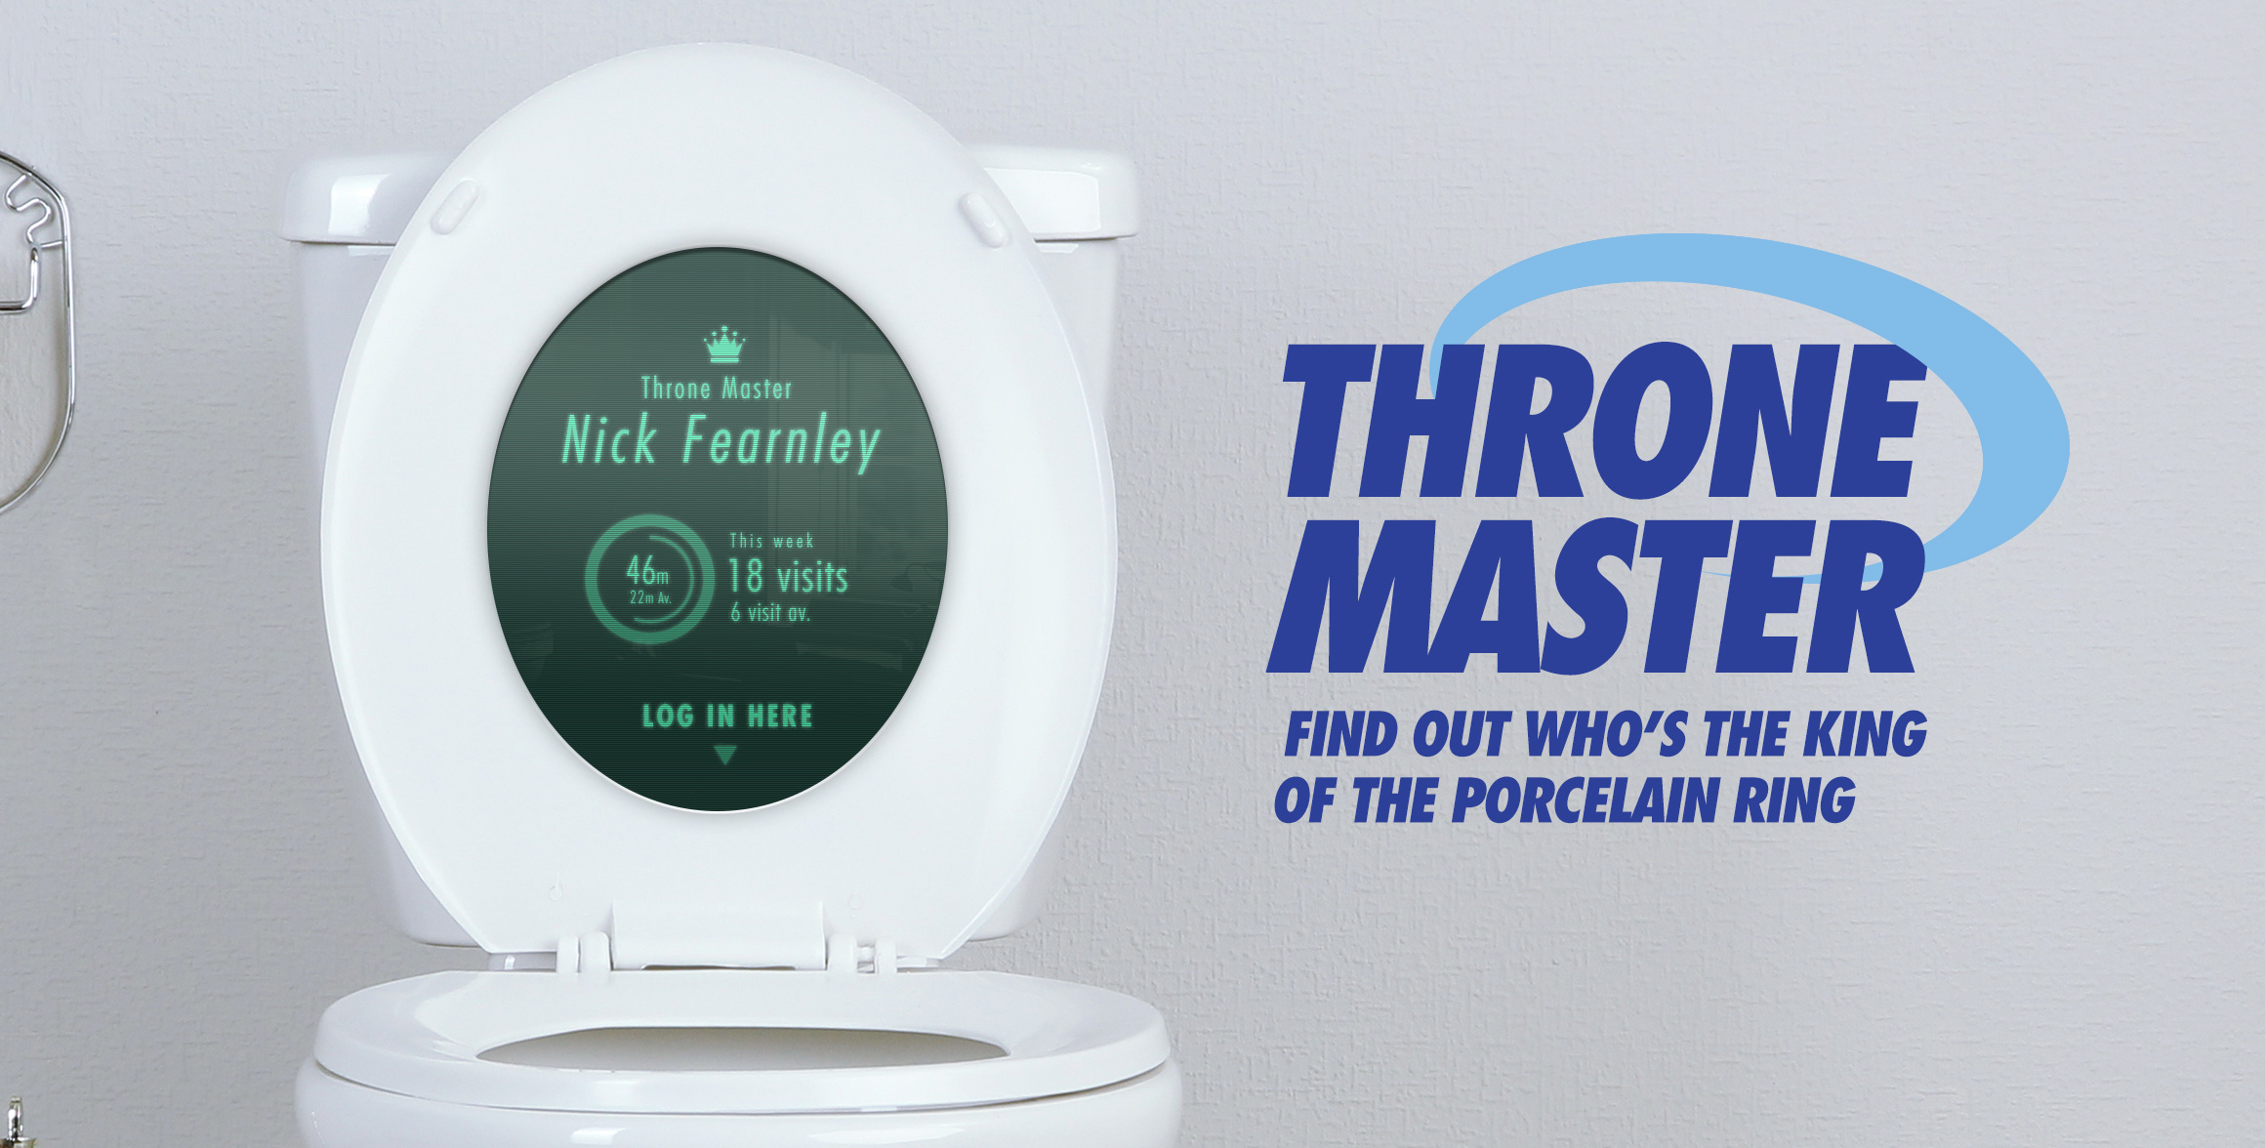
Edge Devices are Ever More Powerful
Notes:
Cite: https://www.bradbox.com/blog/tag/analytics/

Slide 7

Everything Works Seamlessly Together
Notes:
Reprise rest of agenda

Slide 8
DevOps
Then and Now
Notes:
What is DevOps?

Slide 9
DevOps Defined
Wikipedia defines DevOps as
“Academics and practitioners have not developed a unique definition for the term "DevOps."[a][b][c][d]”
When I think of DevOps, I think of these four key components:
Repeatable, Reliable Deployments
Dependency Control
Systems as Artifacts
Continuous Integration and Deployment (CI/CD)
Feel free to define your own DevOps
Notes:
Repeatable, reliable deployments
Dependency control (knowing external dependencies and versions)
Systems as Artifacts (check-in your infrastructure)
CI/CD (ensure stability across changes)

Slide 10

DevOps: A Brief History
“Metal” begets VMs
Hudson begets Jenkins
Chef & Puppet
VMs beget Containers
Vagrant & Docker
Mesos, Swarm, Kubernetes
Notes:
History:
Bare metal deployment
VMs to abstract from metal
Hudson/CC -> Jenkins for stability
Chef/Puppet for multiple components, desired state
Containerization w/ Vagrant & Docker
Multi-container w/ Mesos, Swarm, K8s

Slide 11
Current DevOps: Docker All The Things
Git
Systems as Artifacts
Docker
Repeatable Deployments
Dependency Control
Kubernetes
Scalability
Reliability
Easier Integration CI/CD
Microservices
Easier Dependency Control
Easier Component CI/CD
CI/CD
Many options – we use Azure DevOps
… and Jenkins
… and even Travis
Notes:
Current:
Git to control infra
Docker all the things
K8s for scale
Microservices for sanity
CI/CD for repeatability
Easy to inherit from others, manage and deploy entire clusters with a git push

Slide 12

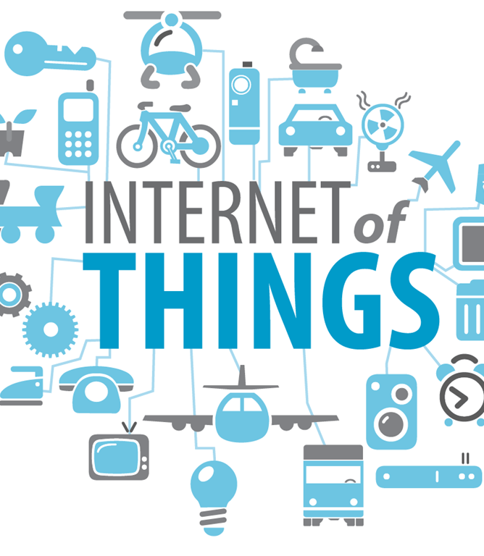
DevOps & IoT
Deploying under constraints in the Internet of Things
This Photo by Unknown Author is licensed under CC BY
Notes:
How does DevOps change in the face of IoT and Edge development?

Slide 13

DevOps for IoT
“Just Deploy Docker”
Constrained memory
Minimal storage
Intermittent network
Deployment landscape is much more complex
Cloud-supported
“Heavy” Edge
“Light” Edge
Notes:
Constraints of edge devices
Sweeping deployment landscape

Slide 14
Edge Deployment
Light and Heavy
 | Cloud: Azure | Heavy Edge |  |  |  | Light Edge
Description | An Azure host that spans from CPU to GPU and FPGA VMs | A server with slots to insert CPUs, GPUs, and FPGAs or a X64 or ARM system that needs to be plugged in to work |  |  |  | A Sensor with a SOC (ARM CPU, NNA, MCU) and memory that can operate on batteries
Example | DSVM / ACI / AKS / Batch AI | - DataBox Edge - HPE Azure Stack | DataBox Edge | Industrial PC | -Video Gateway -DVR | -Mobile Phones -VAIDK | -Mobile Phones -IP Cameras | -Azure Sphere - Appliances
What runs the model | CPU,GPU or FPGA | CPU,GPU or FPGA | CPU, GPU | x64 CPU | Multi-ARM CPU | Hw accelerated NNA | CPU/GPU | MCU
Cloud Consistent
Hybrid Server
PC class devices
Smart Sensors + Ambient AI
Servers
Gateway
Sensors
Notes:
Deployment surface impacts ML capabilities

Slide 15
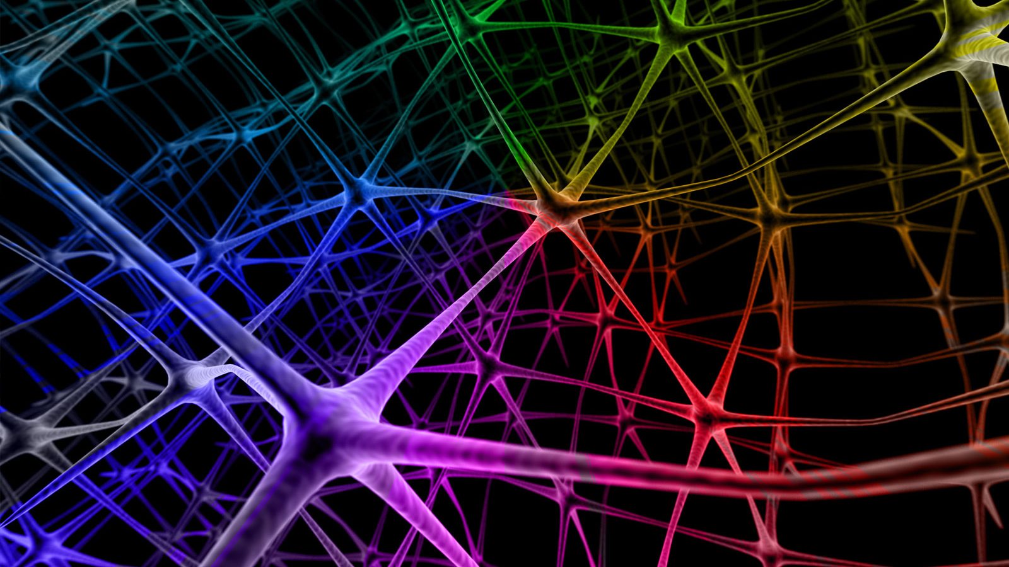
DevOps and ML
Machine Learning Changes the Rules
This Photo by Unknown Author is licensed under CC BY-NC-ND
Notes:
How does “repeatability” change with probabilistic code?

Slide 16
DevOps For Machine Learning
ML Ops
Data Ops

Slide 17
DevOps For Machine Learning
ML Ops
Models can be large
Monitoring model performance
“Flighting”, or A/B Testing
Quantization, compression
Notes:
Size of models, on disk, in memory
Monitoring – performance, drift
Flighting – comparing performance, active learning

Slide 18
DevOps For Machine Learning
ML Ops
Data Ops

Slide 19
DevOps For Machine Learning
Data Ops
Scrubbing
GDPR and You
Lineage tracking
Notes:
Beware leaking training data
Track from dataset to deployed model
GDPR and scrubbing user data

Slide 20
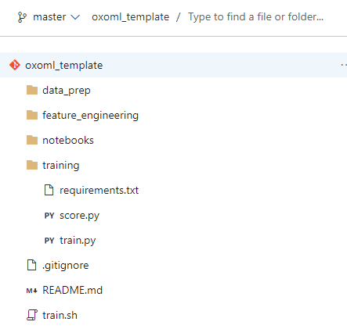
Things to Version
Source Control
Track changes in code (and configuration) over time, integrate work, reproducibility and collaboration.
Dataset Versioning
Training data plays an important role in the quality of the software build. Hence, versioning of data is required for reproduceability.
Model Versioning
Version trained models in relation to code and training data for traceability.
Experiment Tracking
Version model experiment runs to understand which code, data and e.g. selected features led to what output and performance, and allow for reproducibility.
Notes:
Source + Infra
Data + dictionaries
Train/test/validation split logic + random seeds
Models (traceable back to data, with performance metrics)
Experiments + feature engineering
We’ve mainly used Azure ML, DataBricks, and MLFlow

Slide 21
ML Ops in the Real World
Stories from the Field
Notes:
Real world scenarios from my team

Slide 22
My Team In Brief
Strategic Partners
Microsoft’s Largest Customers
But… sometimes not
Or… sometimes on strange projects
Code-With
Code side-by-side with their developers
Same for the data science side
Technical Depth
IoT, DevOps, Data at Scale, Blockchain, Augmented Reality
And, of course, ML and DL
Cross-Domain ML Expertise
NLP, CV, Audio, Time-series
Necessarily this means lack of depth for the team
We have specialists in certain areas
We can supplement with Microsoft Research
Long-term Azure Enablement
Allows us to work on non/low-Azure engagements
Do good work, establish confidence, report feedback
Notes:
Strategic partners
Code-with + DS-with
Broad depth
Cross-domain, shallow + deep
Azure unlock, product feedback, open source

Slide 23
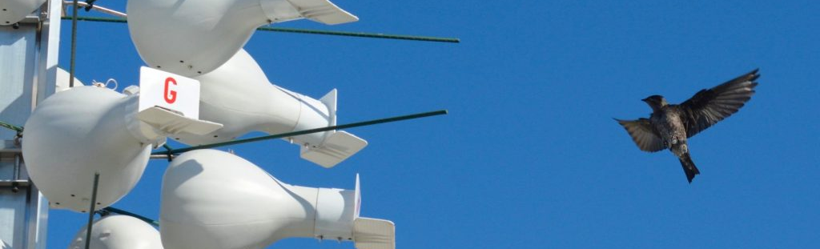
Data Leaving the Nest
Disney and our team
Monitor the purple martin
In-nest / on-nest
Custom enclosures
Monitoring
Network issues
Model compression
Pull deployments
Notes:
Purple martin history
Extreme deployment scenario
Safe for the birds

Slide 24
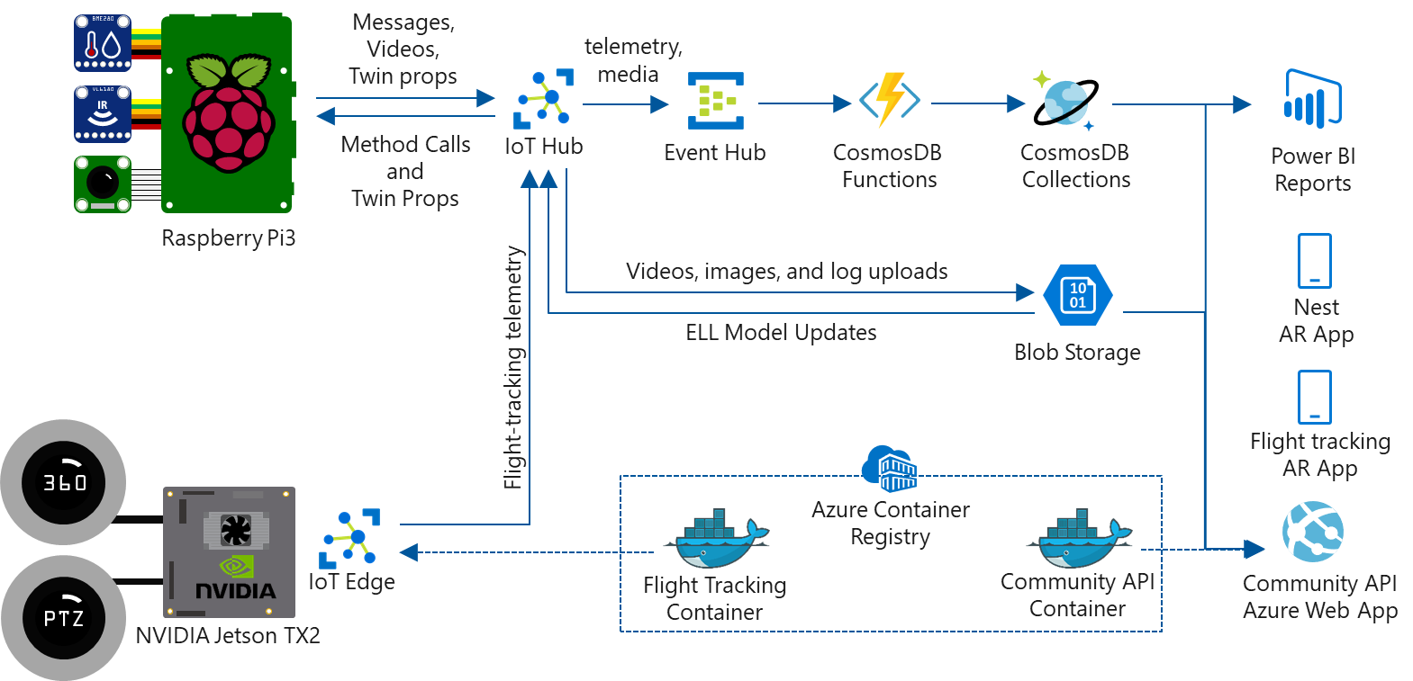
Notes:
In-nest w/ IR
On-nest
360 + PTZ + Jetson
ELL for compression
Devices self-bootstrapping, self-updating

Slide 25
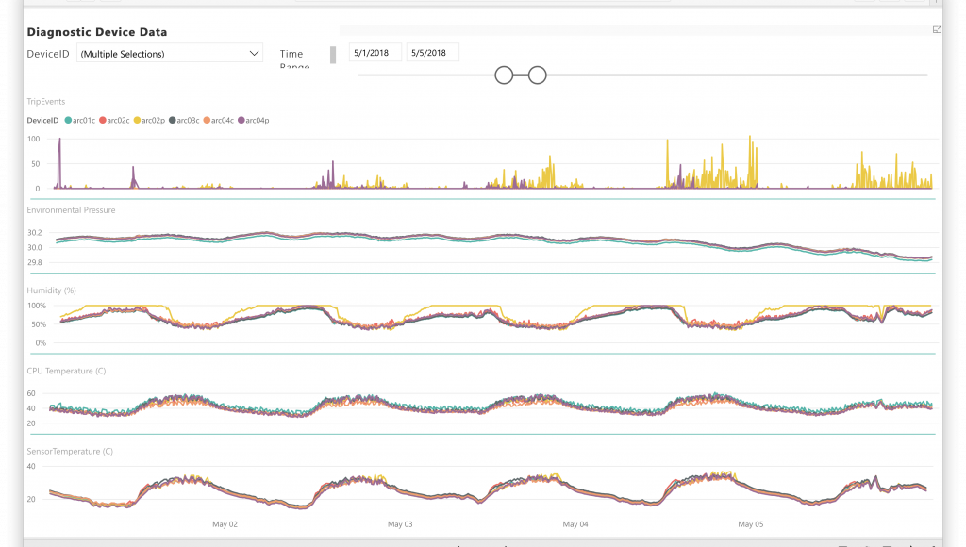
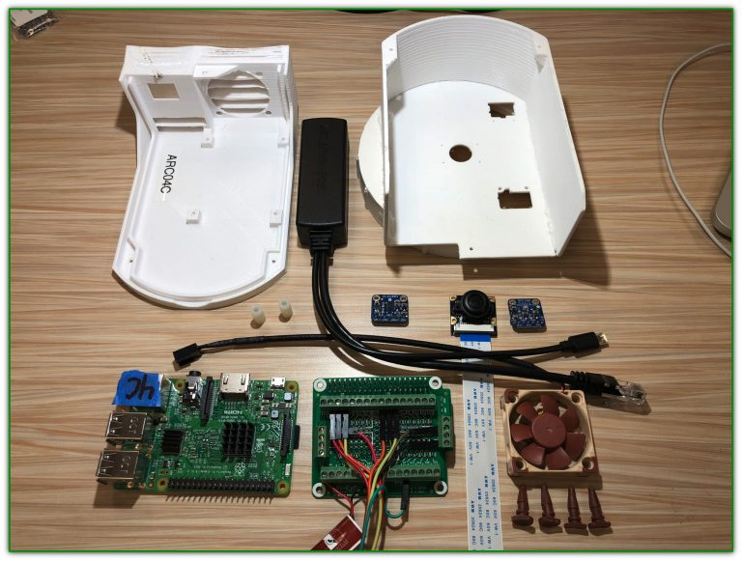
3D Printing and Power BI
Nests equipped with HD infrared cameras
Sensors track temperature, humidity, etc.
Temperature can trigger the camera to turn off, to avoid harming the birds
Camera spools footage in rolling buffer
Intermittently pulls key frames
Model determines if they’re “interesting”
Video clip uploaded
Notes:
IR camera for bird/egg development in-nest
Sensors in-nest + out
Rolling buffer + keyframes determine upload

Slide 26
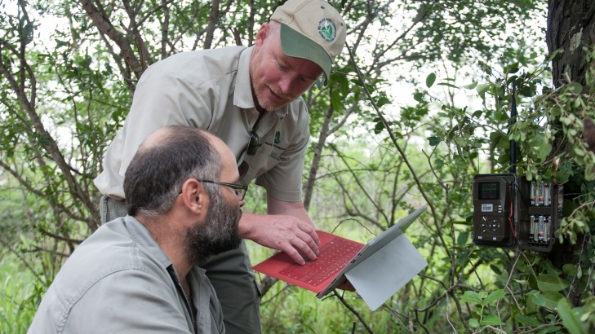
Deploying in the Wild
Work with Peace Parks to prevent rhino poaching
Easiest way to field-deploy a model… Don’t
Inference in the cloud
Allows cohesive solution at expense of latency
Notes:
Sometimes cloud-based models are best
Quick iteration, great for revisiting old data w/ new models
Eventual goal = on-device deployment for real-time anti-poaching action

Slide 27
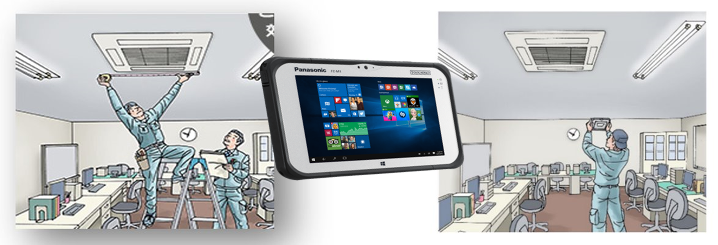
Toughening Up Continuous Integration
On-device app/model integration
The many meanings of performance
ONNX, or lies we tell ourselves
Notes:
App-based models w/ ONNX
Prove out platform hardware, skillset of Panasonic devs/DS
Simple models can bring large gains

Slide 28



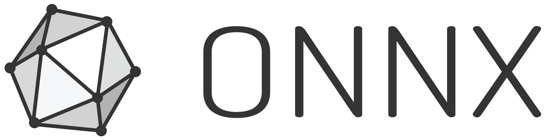




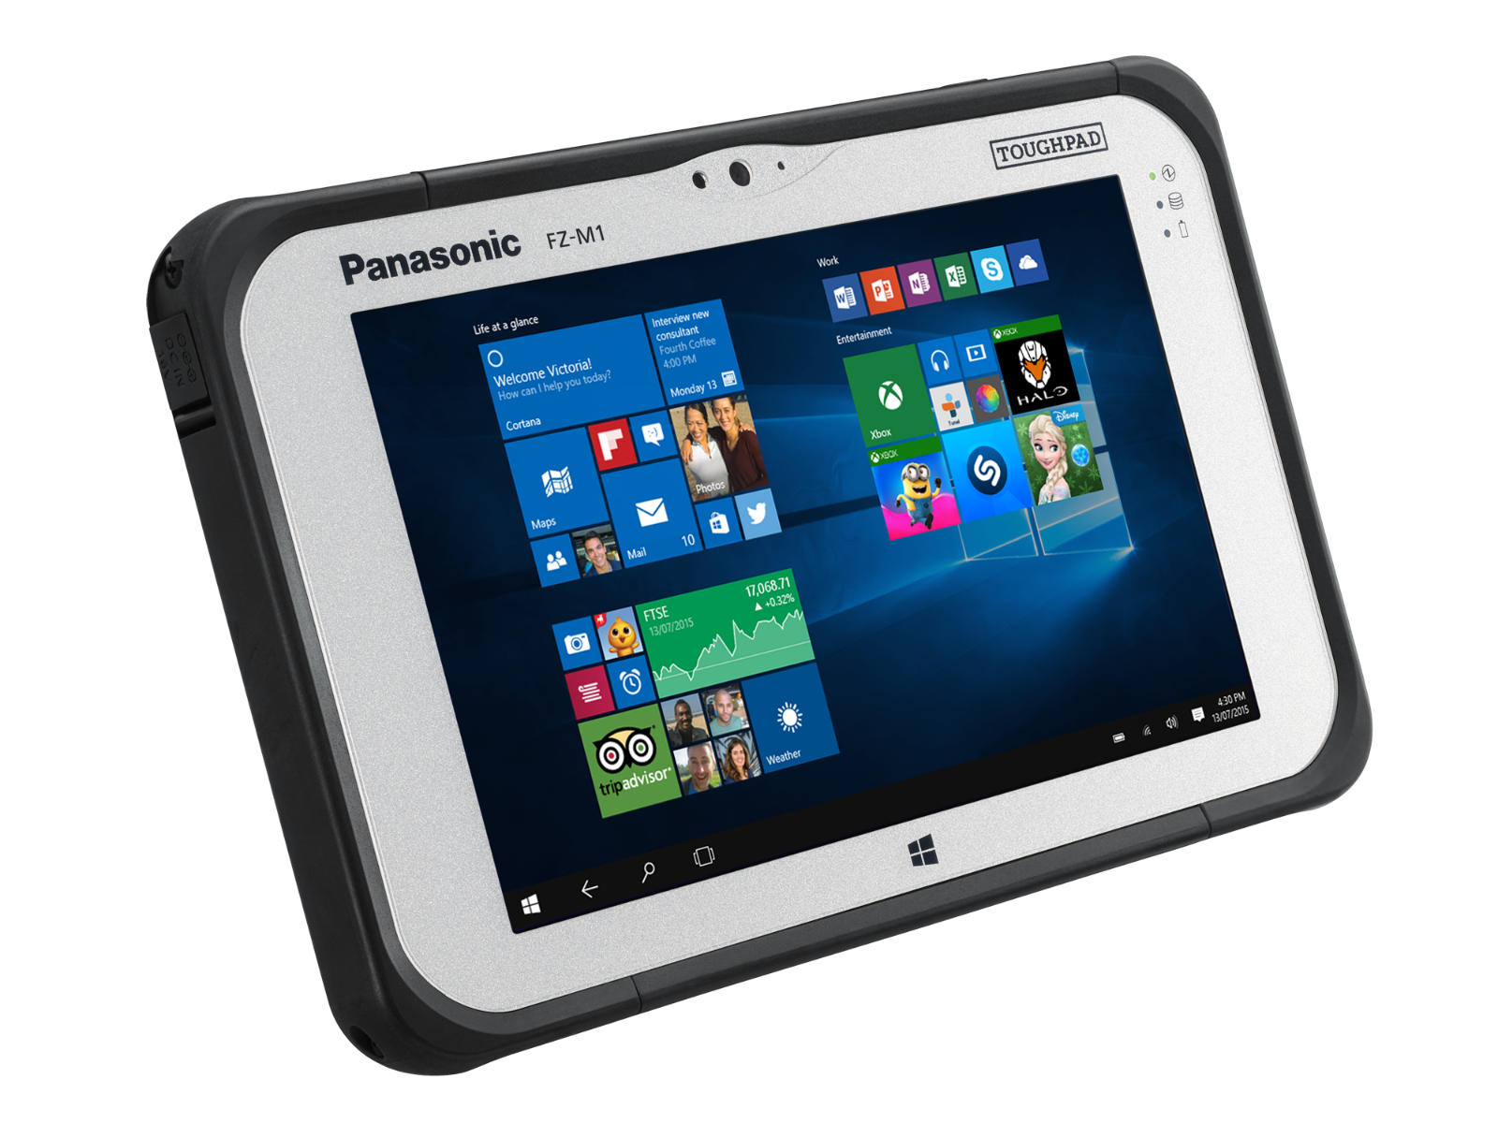

MLOps Using Azure ML
Azure Pipelines
Run linter
Run tests
Kick off
Training &
Evaluation
Compare metric
on the best model
CD for on-device deployment
Azure Git Repository
On-device
AML
Datastore
AML Compute
Azure Blob Storage
Field Engineer
C# Native App (WPF)
C# Native App (WPF)
Annotator
AML Run
History
AML Model
Repository
Azure ML Service
Notes:
Training code or data changes trigger a training build
If new model outperforms, register
Deploy to device from cloud, test SLA
ONNX issues, so short-term mitigate w/ Flask

Slide 29

ML on Cruise Control
What if “the Edge” was actually a boat?
We partnered with Royal Caribbean Cruise Lines
On-board “Data Center”
GPU Servers
VERY occasional network connectivity
Only when in port (at least for our purposes)
Notes:
Heavy edge: GPU in on-ship DC
Good, but very intermittent connectivity

Slide 30
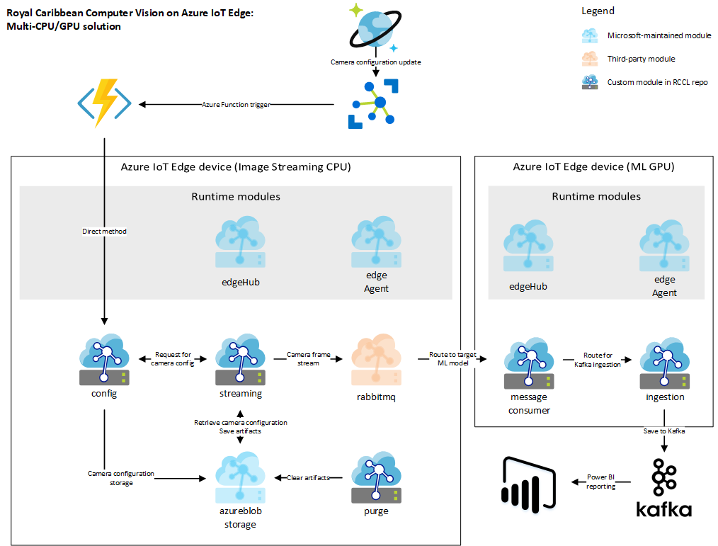
Notes:
Azure IoT Edge
If not
Intermittent connectivity
Local storage + monitoring of such
Quick upload/download when triggered
No quantization/compression needed

Slide 31

<Redacted>
Notes:
Finally, there are a few other projects we’ve worked on or are currently working on where … we can’t really talk about them in any detail. However, the ones I’ve chosen and the general talking points I’ve covered deal with most of the issues we’ve encountered even in the projects we’re not allowed to talk about.

Slide 32
What’s Next?

Slide 33
How DevOps is Evolving
DevOps
Cluster Orchestration
Storage DevOps
Git Ops
IoT DevOps
Edge Clusters
Better Resource Control
ML DevOps
Better separation of concerns
Concept Drift

Slide 34
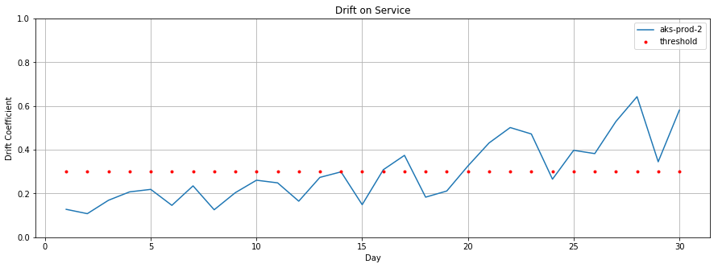
Data Drift
Training Env
Inferencing Env
What is Data Drift
Drift contribution of all features in the model
access to raw training and inferencing data in AML workspace for further debugging
Configurable service with standard distance measures (e.g. Kullback-Leibler, Battacharayata)
When data served to model in prod (inferencing stack) is different from the data that the model was trained on, it is called data drift
Why is Data Drift important
Data drift is one of the top reasons where model accuracy degrades in prod
Time to detect data drift ranges from days to weeks
What can I expect from data drift service
Monitoring of drift through alerts, and visual indicators
Model accuracy has a significant business impact in terms of costs and revenue
Our solution detects concept drift over entire datasets
Model
Training Data
Feedback Data
Data Drift Service
Notes:
One of top reasons for model degradation
Hard to detect through manual observation

Slide 35
Useful Resources
DevOps
Azure DevOps, Jenkins, Travis
https://azure.microsoft.com/en-us/services/devops/
https://jenkins.io/
https://travis-ci.org/
IoT Ops
Azure IoT Edge
https://azure.microsoft.com/en-us/services/iot-edge/
Azure IoT Edge AI Toolkit
https://github.com/Azure/ai-toolkit-iot-edge
ML Ops
Azure ML / MLFlow
https://docs.microsoft.com/en-us/azure/machine-learning/service/
WinML / ONNX / ELL
https://onnx.ai/
https://pypi.org/project/winmltools/
https://microsoft.github.io/ELL/
My Team’s Resources
https://www.microsoft.com/developerblog/
https://github.com/microsoft/MLOps
https://mlflow.org/

Slide 36
Questions?
I’m Hiring: https://aka.ms/mltjob
Link to this deck: https://aka.ms/mlt2019

